Slide 1


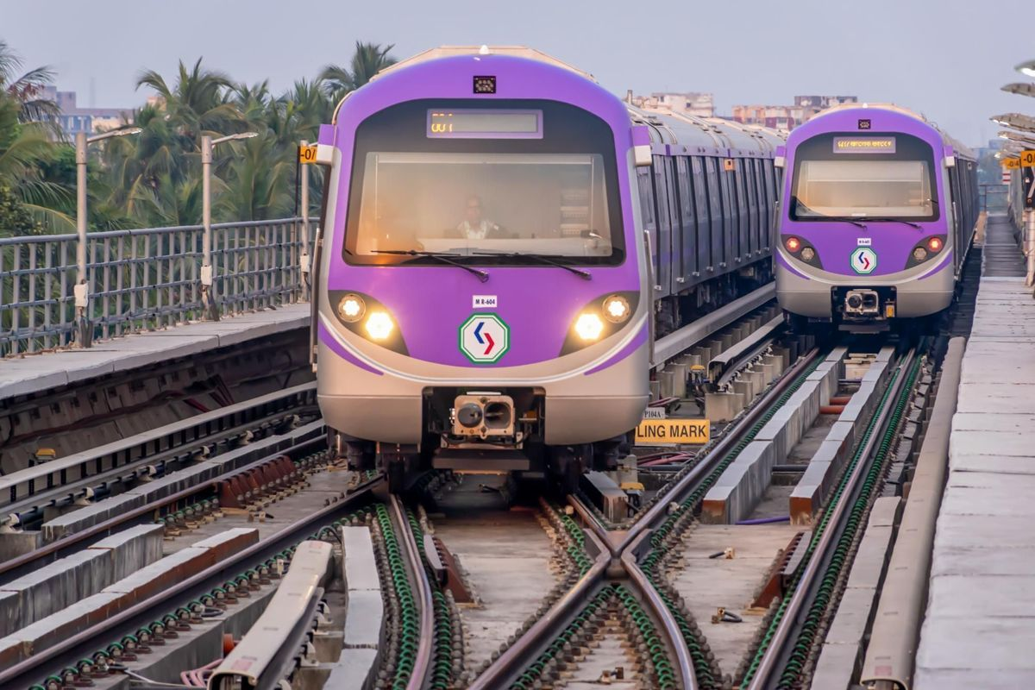
AI-Enabled Dead-End Platform Breach Prevention System

Slide 2


INTRODUCTION
Passengers often stand dangerously close to the edge of metro platforms, increasing the risk of accidental falls or intentional track intrusions. Existing safety measures lack real-time, zone-specific monitoring. The AI-Enabled Dead-End Platform Breach Prevention System addresses this by using IR and LDR sensors with an ESP8266 microcontroller to continuously monitor platform safety zones. The system provides instant audio-visual alerts during unsafe activity and displays live zone status on a local web-based dashboard. This low-cost, automated solution enhances passenger safety and helps prevent accidents and service disruptions.

Slide 3
PROBLEM STATEMENT
To highlight the need for automated zone-based monitoring, we reviewed recent Kolkata Metro incidents showing how intrusions, falls, and intentional acts can disrupt service and pose serious safety risks.
01
Fall at Central Station (July 12, 2025):
A passenger fell onto the tracks, triggering emergency response and causing major service disruptions.
Chandni Chowk Station (January 2025):
A senior citizen jumped in front of an incoming metro train, causing a fatality and over two hours of service suspension, highlighting the limits of manual monitoring in preventing intentional intrusions.
03
02
Passenger Fall at Esplanade (Dec 12, 2024): A passenger fell onto the tracks due to overcrowding and possible pushing, highlighting the need for localized platform safety warnings
04
Service Disruption at Jatin Das Park (Sep 26, 2025): A person fell onto the tracks, disrupting Blue Line services for nearly an hour and causing widespread commuter delays.

Slide 4
GOALS
Primary objective: consolidate the present multi-controller architecture (three microcontrollers each with its own webserver) into a single-controller, single-webserver system to improve manageability, reduce cost and simplify deployment.
Benefits
Implementation considerations
Short roadmap for the PPR:
Reduced hardware cost: One controller replaces multiple boards, cutting equipment and spare-part costs.
Simplified management & maintenance: Single firmware and network endpoint make updates and troubleshooting easier.
Unified dashboard & logging: One web interface enables consistent monitoring and easy event analysis.
Single controller for all zones: Use a high-I/O microcontroller or I/O expanders to monitor every zone with one network host.
Centralized webserver: One dashboard with unified status/REST endpoints simplifies system configuration and monitoring.
Fault tolerance: Add a watchdog and backup controller to prevent total system failure.
Single-controller prototype: Build on a high-GPIO/expandable board and verify detection and alert latency.
Performance evaluation: Compare latency, false positives, and uptime with the three-controller system.
Deployment & cost analysis: Create expansion guidelines and estimate cost savings for large-scale rollout.

Slide 5


SYSTEM DESIGN
AI Camera Module
Laser Transmitter
Laser Receiver
Microcontroller (Arduino / ESP32 / Raspberry Pi)
Buzzer
LED Indicator
Power Supply Unit
Connecting Wires
Mounting Frame / Holders
Storage Module (SD Card / Cloud Interface)
Dashboard Interface (Display/PC/Monitoring Unit)

Slide 6

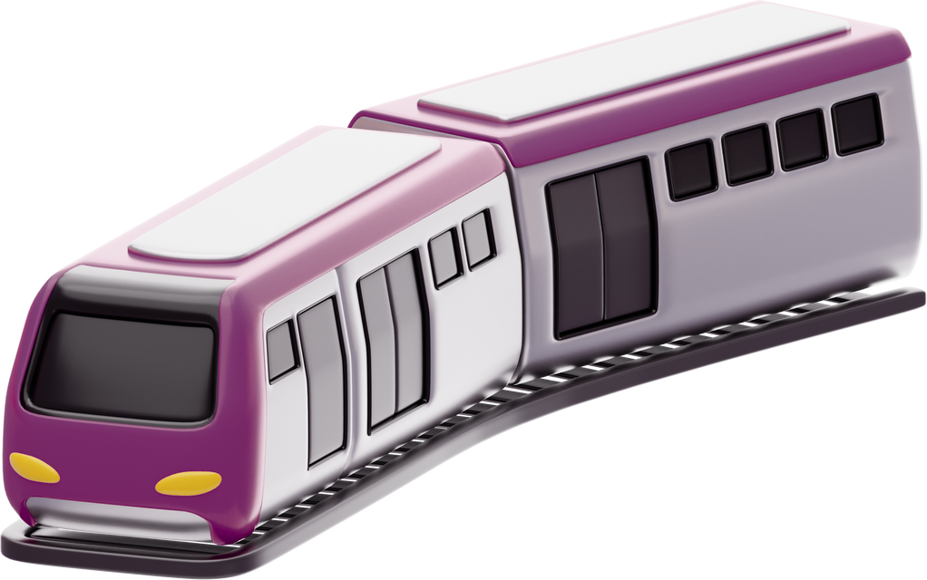
WORKING PRINCIPLE
System Power on
Area Under Surveillance
Normal Safe Condition
Human Approaches Danger Zone
Alert Activated
Violation Confirmed
Dual Verification
Laser Beam Interrupted
Data Logging
System Reset

Slide 7


System Overview
For full system information and demo please scan the QR code

Slide 8


